Slide 1
Early Sixteenth Century Poetry and the Reformation
Dr. Alan Haffa

Slide 2
Overview
Renaissance Defined
Italian Influence and Petrarch an Sonnet
Medieval forms of poetry
Political and Religious censorship
As the Reformation and Counter Reformation advance, poets are more cautious about religious themes.
Secular themes and vernacular language
Admiration and competition with ancients

Slide 3
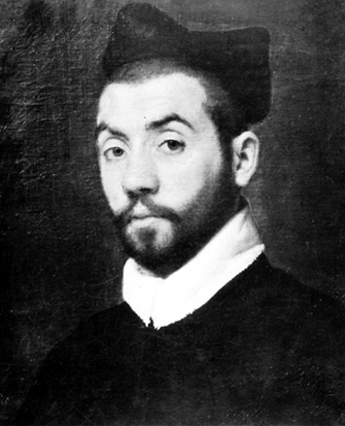
Clement Marot (1495-1544)
Served Francis I and Marguerite de Navarre
Christian Humanist
Affair des Placards, 1534; Fled to Ferrara
Met Calvin at Ferrara, 1536
1539 Pope Paul III persuaded Francis to allow Huguenots back if they recanted
Translation of Psalms
Sorbonne condemned Psalms; flight to Geneva 1543
Lived in Geneva in the 1540s before leaving due to the strictness of life there
Notes:
arrested on charge of heresy and then released

Slide 4
"Chant royal de la conception Nostre Dame" 1533
Chant royal: Medieval French Form
Imagines a beauty contest for the selection of Mary as the Mother of Christ
Deliberately recreates the Judgment of Paris from Greek Myth
“Dedans Syon au Pays du Judée Fut un debat honneste suscité Sur la beaulté des Dames collaudée Diversement par ceulx de la Cité”
Notes:
Similar in form to Song of Roland: Envoy and then a concluding stanza

Slide 5
Song of Songs is echoed, as the choice is made by virtue of the sound of the women’s voices: “My dove, hiding in the clefts of the rock in the coverts of the cliff, show me your face, let me hear your voice; for your voice is sweet and your face is beautiful.”
A reference to Ulysses and Sirens, and how Mary’s voice surpasses them.
Le divin Verbe est la voix, & alaine, Qui proceda d'organe non vilaine C'est de Marie, où tous biens sont compris.

Slide 6
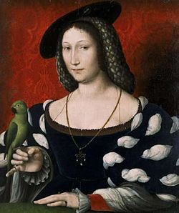
Marguerite de Navarre (1492-1549)
Sister of Francis I, King of France and grandmother of King Henry IV
Patron and protector of Calvin, Marot, and Rabelais and other protestants
Heptameron: Stories emphasize Chastity as pathway to God
“Mirror of the Soul” 1548; condemned by Sorbonne but revoked after King’s intervention; Narrator confesses to her own image—the Word in her. Elizabeth I, Tr.
Notes:
Heptameron is a series of stories similar to Boccaccio and Chaucer, but more religious in focus and emphasize the joys of chastity leading to a closer relationship with God

Slide 7
Introduction to “Le Miroir de l’âme pécheresse,” 1531
Si vous lisez ceste œuvre toute entiere, Arrestez vous, sans plus, à la matiere, En excusant la rhythme et le langage, Voyant que cest d'une femme l'ouvrage, Qui n'a en soy science, ne sçavoir, Fors un desir, que chacun puisse voir Que fait le don de DIEU le Createur, Quand il luy plaist justifier un cœur : Quel est le cœur d'un homme, quant à soy, Avant qu'il ayt receu le don de Foy, Par lequel seul l'homme a la congnoissance De la Bonté, Sapience et Puissance.

Slide 8
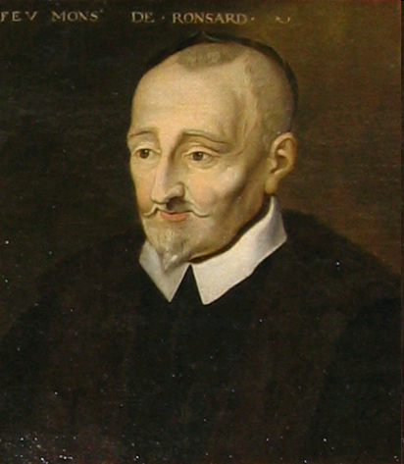
Pierre de Ronsard (1524-1585):
Leader of La Pleiade: Modelled on an ancient Greek group of 7 Poets
Program: Break with the past generation of French poets called Rhetoriquers (who were too Medieval)
Used Myth extensively
Used Greek and Roman forms and abandoned French, Medieval forms
http://www.tonykline.co.uk/PITBR/French/Ronsard.htm
Notes:
: Ronsard, Joachim du Bellay, Jean-Antoine de Baif,

Slide 9
ON HIS LADY'S WAKING, 1550
My lady woke upon a morning fair, What time Apollo's chariot takes the skies, And, fain to fill with arrows from her eyes His empty quiver, Love was standing there: I saw two apples that her breast doth bear None such the garden of the Hesperides Yields; nor hath Venus any such as these, Nor she that had of nursling Mars the care. Even such a bosom, and so fair it was, Pure as the perfect work of Phidias, That sad Andromeda's discomfiture Left bare, when Perseus passed her on a day, And pale as Death for fear of Death she lay, With breast as marble cold, as marble pure.

Slide 10
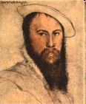
Sir Thomas Wyatt (1503-1542)
Poet and Diplomat
Lover of Lady Anne Boleyn; Wyatt imprisoned
Patron, Sir Thomas Cromwell executed in 1541
Wyatt imprisoned and then reconciled with King.

Slide 11
Wyatt’s Poetic Accomplishments
Pioneered English Blank Verse
Translated Petrarch’s Sonnets
Adapted the Italian verse forms by adding a political or courtly subtext to love lyrics, as in Whoso List to Hunt; the “deer belonging to Caesar” refers to Anne Boleyn.

Slide 12
Who so list to hunt, I know where is an hind,
But as for me, alas, I may no more:
The vain travail hath wearied me so sore.
I am of them that farthest cometh behind.
Yet may I by no means my wearied mind
Draw from the deer: but as she fleeth afore,
Fainting I follow. I leave off therefore,
Since in a net I seek to hold the wind.
Who list her hunt, I put him out of doubt,
As well as I, may spend his time in vain:
And, graven with diamonds, in letters plain
There is written her fair neck round about:
Noli me tangere, for Caesar’s I am,
And Wild for to hold though I seem tame.

Slide 13
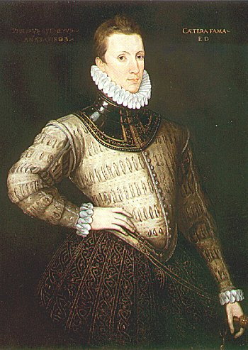
Sir Philip Sidney (1554-1586)
From “Astrophil and Stella”
Loving in truth, and fain in verse my love to show,
That she, dear she, might take some pleasure of my pain,
Pleasure might cause her read, reading might make her know,
Knowledge might pity win, and pity grace obtain,
I sought fit words to paint the blackest face of woe:

Slide 14
Observations on Astrophil and Stella 1
Meter: Iambic hexameter
Use of Caesura to emphasize flow of ideas
Repetition of key words from phrase to phrase also makes verse flow and links idea development
Poetic Idea: Writing as a means to inspire Love
Importance of expressing one’s heart rather than being too learned
Classic Question: should a poet “feel” more than “study”

Slide 15
Summary
Early 16th century French poets were influenced by Medieval forms: Ballades and Chansons
As the Reformation spread, poets were less comfortable writing directly about religion.
Ronsard, Du Bellay and La Pleiade were the next wave of poets; Catholic in religion, royalists in politics, but advocates of French as a new literary language
This new generation imitated Renaissance Italian writers like Petrarch and Greek and Roman writers
The English Renaissance was inspired by the Italian
English Renaissance writers adapt the Sonnet
English poets integrate sacred and personal

